Slide 1

Modern Analytics Academy “Vignettes”
Follow up to Modern Analytics Academy: https://aka.ms/maa
Topical sessions that addresses:
New features and how to use them
Frequent questions we receive
Updates to a previous session
Pardeep Singla
Cloud Solution Architect

Slide 2
Modern Analytics Academy “Vignettes”
Polybase vs Copy
https://aka.ms/maa
Pardeep Singla
Cloud Solution Architect

Slide 3





Academy Sessions
Acquisition & Storage
Modeling
Pipelines
Security & Governance
Visualization
Azure Data Lake
Azure Cosmos DB
Azure Event Hubs
Synapse Link
Data Lake Structure
Synapse Spark Pools
Synapse SQL Pools
Synapse Serverless SQL
Azure Data Factory
Synapse Pipelines
Power BI Dataflows
Azure Stream Analytics
Auditing
Security
Azure Purview
Power BI
Paginated Reports
Power BI Embedded

Slide 4
Agenda
Overview
Demo
Polybase vs Copy

Slide 5
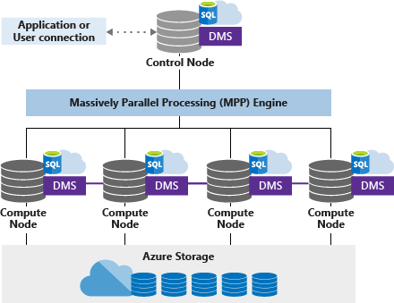
Overview
Synapse Dedicated SQL Pool Architecture

Slide 6
Data Loading Approaches
Single Gated Load (bcp, SQLBulkCopy)
Parallel Load(Polybase, Copy)

Slide 7
PolyBase
PolyBase unifies data in relational data stores like Azure Synapse dedicated sql pool with non-relational data stores.
PolyBase allows you to create an external table in Azure Synapse dedicated sql pool that references the data stored in Azure Blob Storage or in Azure Data Lake.
Create Master Key for database, Create Database Scoped Credential, Create External Data Source, Create External File Format, Create External Table and then perform the load from External Table to Synapse native Table.
Create Table as Select(CTAS) for Data Importing
Create External Table as Select(CETAS) for Data Exporting.

Slide 8
Copy
Allow lower privileged users to load without needing strict CONTROL permissions on the data warehouse
Leverage only a single T-SQL statement without having to create any additional database objects.
COPY INTO statement for importing the data.

Slide 9
Comparison
Polybase | Copy
GA | GA
Requires controlled permissions like creating master key, database scoped credentials | Does not require control permissions
Need extra steps before running actual polybase command(ctas or cetas) like “create external data source” or “create external file format” | Does not require extra steps, just have to run one command “Copy into” (Expects table already exists)

Slide 10
References
Polybase documentation
https://docs.microsoft.com/en-us/power-apps/maker/data-platform/export-to-data-lake
https://medium.com/microsoftazure/practical-tips-on-data-load-to-synapse-using-polybase-aeba9866692f
Copy documentation
https://learn.microsoft.com/en-us/sql/t-sql/statements/copy-into-transact-sql?view=azure-sqldw-latest
https://techcommunity.microsoft.com/t5/azure-synapse-analytics-blog/how-to-use-copy-into/ba-p/1298242

Slide 11
Agenda
Overview
Demo
Polybase vs Copy

Slide 12
Thank you!
Modern Analytics Academy “Vignettes”
Polybase vs Copy
https://aka.ms/maa

